Slide 1

Ho Chi Minh City University of Transport
Image Processing and Computer Vision
2D Object Detection
Tran Le Anh
anhtl@ut.edu.vn
05-2025

Slide 2
Object Detection
Algorithms

Slide 3
Object Detection
Algorithms

Slide 4
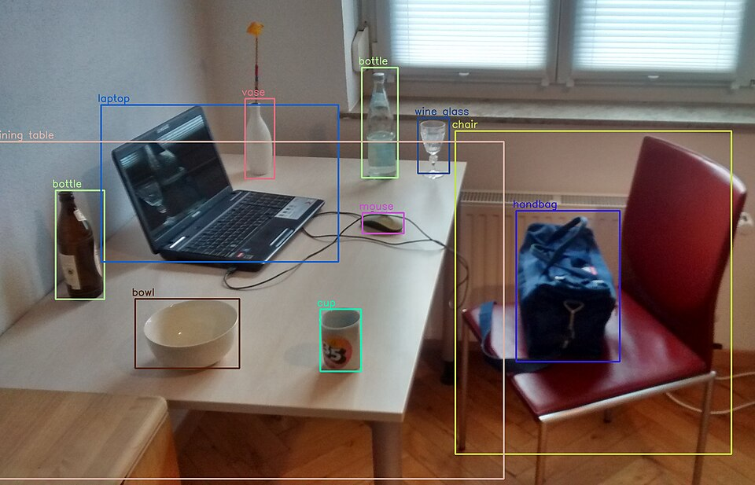
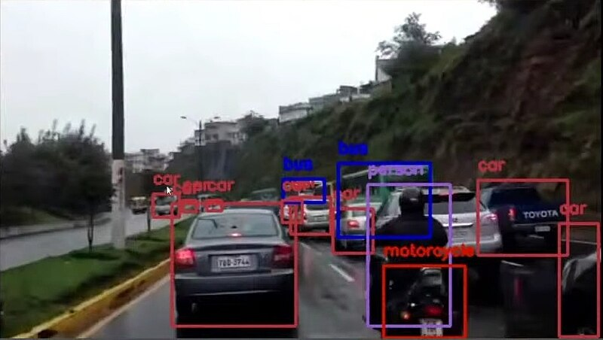
Object Detection
Introduction
- Object detection is a computer vision technique that identifies and localizes objects within images or videos.
- Object detection not only identifies objects but also determines their precise location within the image using bounding boxes.
Ref: https://en.wikipedia.org/wiki/Object_detection

Slide 5
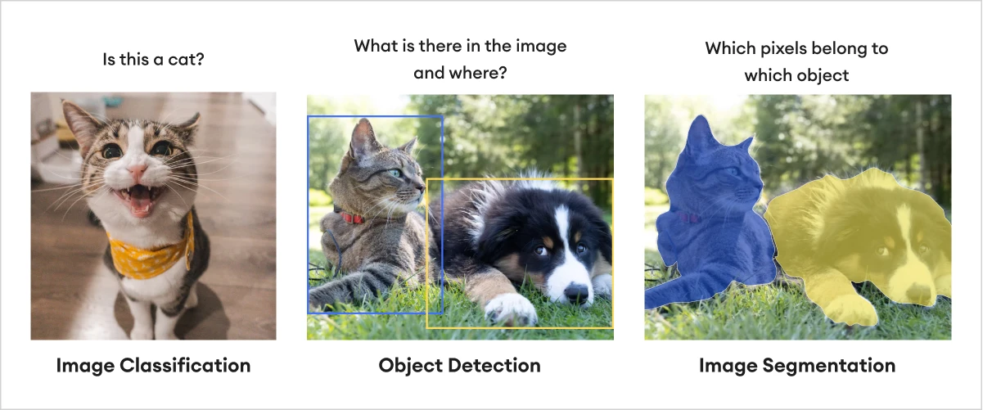
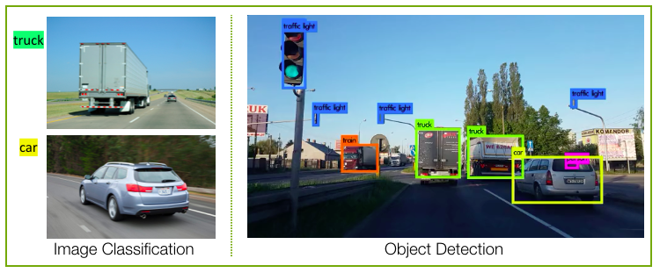
Object Detection
Introduction
Ref: https://zilliz.com/learn/what-is-object-detection

Slide 6
Object Detection
Key Components
- Classification: Identifying what the object is.
- Localization: Finding where the object is.
- Bounding boxes are drawn around objects of interest in images.
Ref: https://docs.aws.amazon.com/rekognition/latest/dg/images-displaying-bounding-boxes.html

Slide 7
Object Detection
Applications
- Autonomous vehicles
- Surveillance and security
- Medical imaging
- Augmented reality

Slide 8
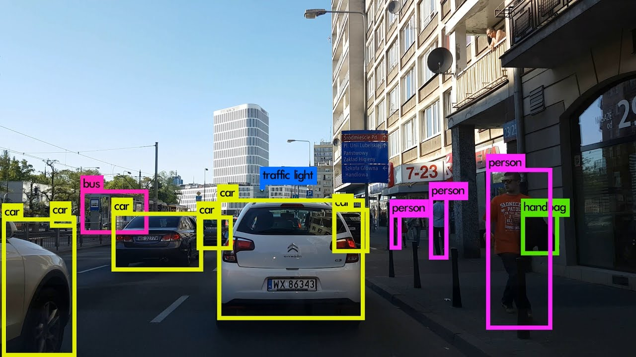
Object Detection
Applications
- Autonomous vehicles
- Surveillance and security
- Medical imaging
- Augmented reality
Ref: https://www.labellerr.com/blog/why-do-autonomous-vehicles-need-object-detection/

Slide 9
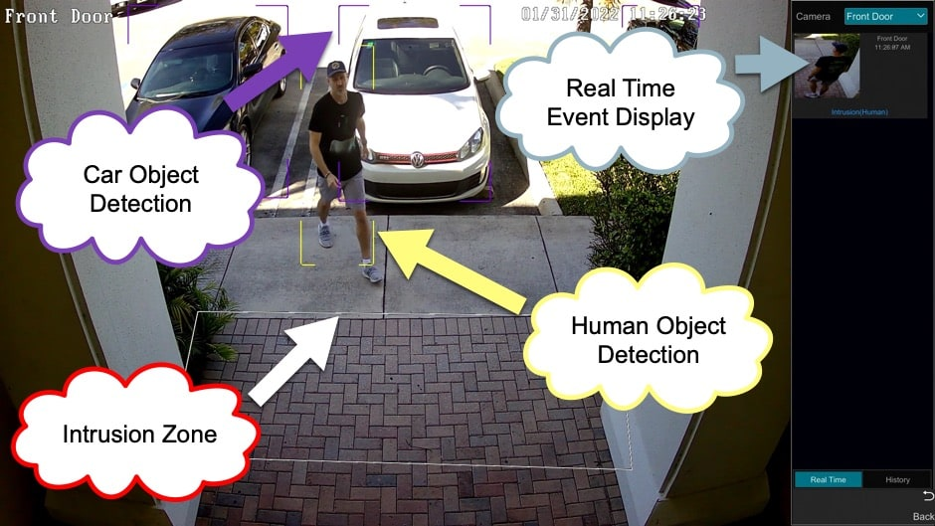
Object Detection
Applications
- Autonomous vehicles
- Surveillance and security
- Medical imaging
- Augmented reality
Ref: https://videos.cctvcamerapros.com/v/ai-security-camera-object-detection.html

Slide 10
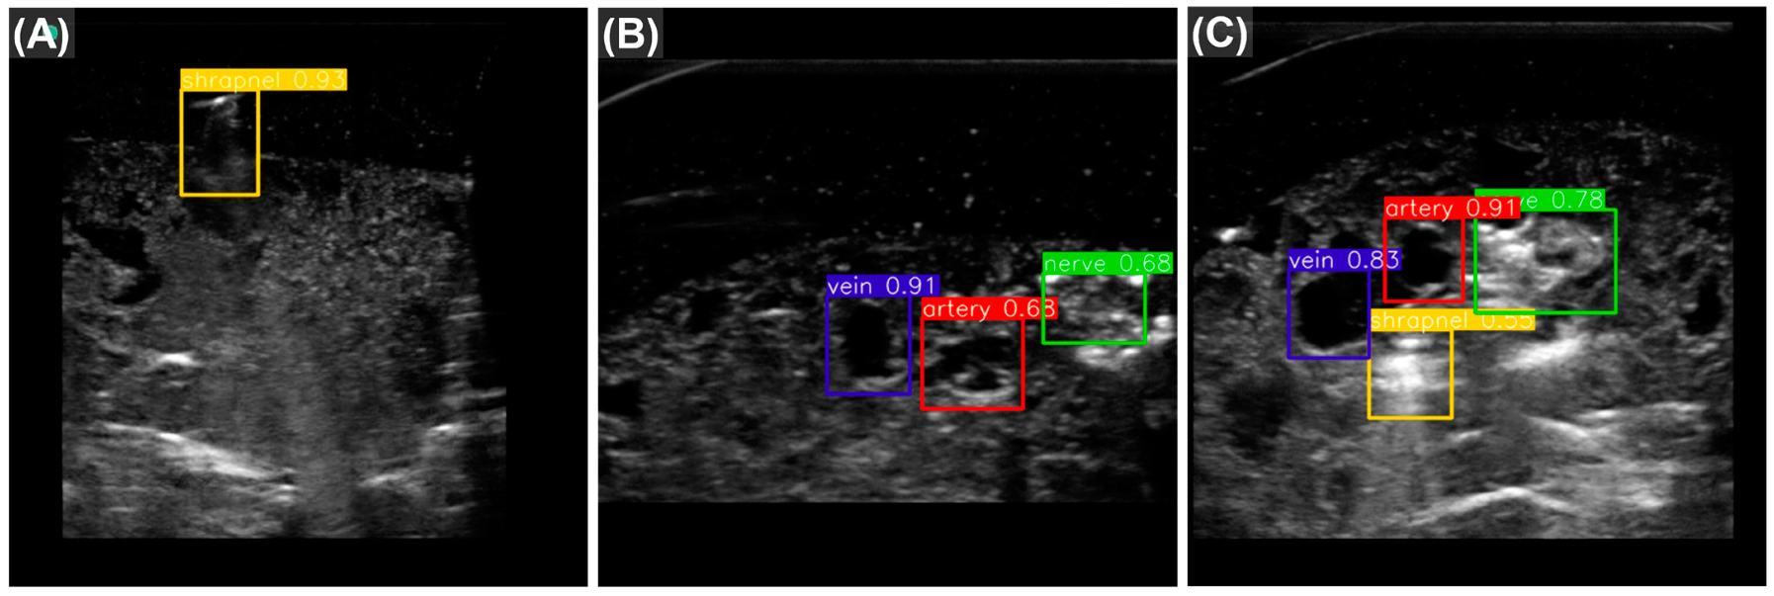
Object Detection
Applications
- Autonomous vehicles
- Surveillance and security
- Medical imaging
- Augmented reality
Ref: https://www.mdpi.com/2306-5354/10/7/807

Slide 11
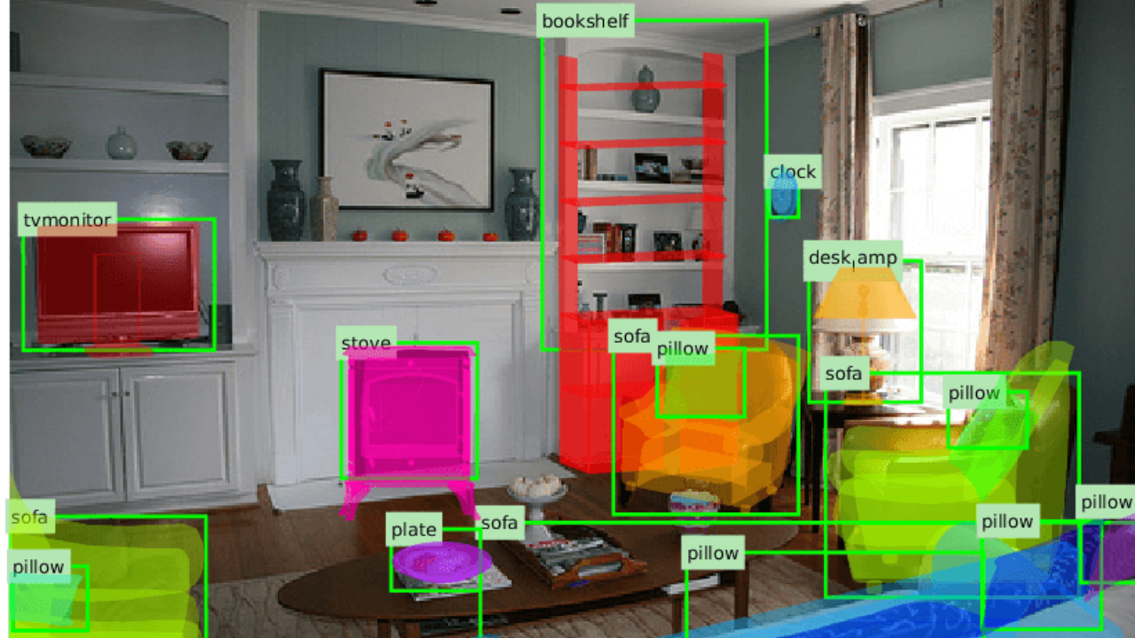
Object Detection
Applications
- Autonomous vehicles
- Surveillance and security
- Medical imaging
- Augmented reality
Ref: https://www.augmentedstartups.com/blog/what-is-object-recognition-a-comprehensive-guide-to-visual-perception

Slide 12
Object Detection
Evaluation Metrics
- IoU (Intersection over Union)
- mAP (mean Average Precision)
- Precision, Recall, F1-score

Slide 13
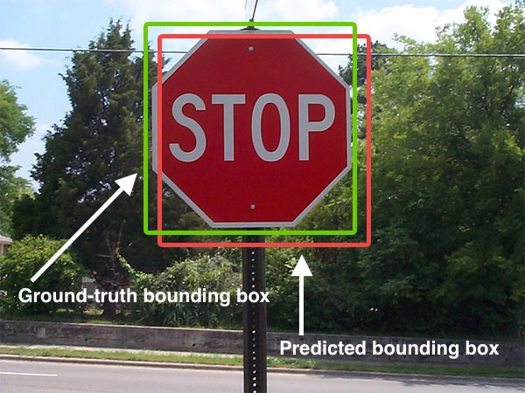
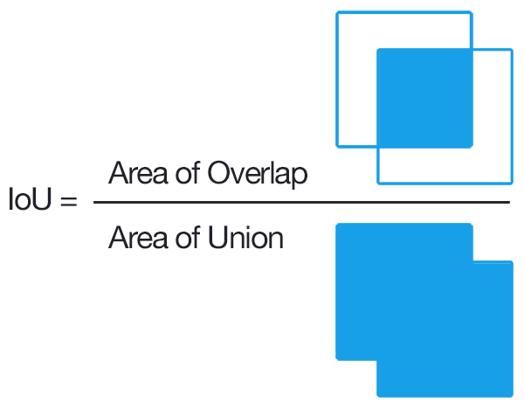
Object Detection
IoU (Intersection over Union)
- IoU is achieved by quantifying the degree of intersection of two boxes which are the true box (ground truth) and the predicted box.
Ref: https://en.wikipedia.org/wiki/Object_detection

Slide 14
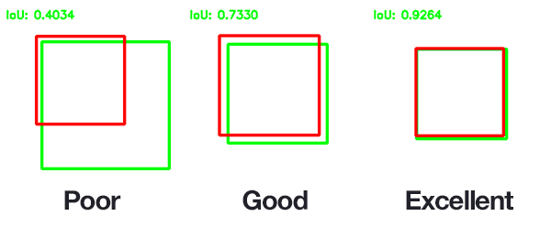
Object Detection
IoU (Intersection over Union)
- If IoU ≥ threshold → the predicted box = true positive.
- If IoU < threshold → the predicted box = false positive.
- If a true object is not detected → the ground truth label has a false negative.
Ref: https://en.wikipedia.org/wiki/Object_detection

Slide 15
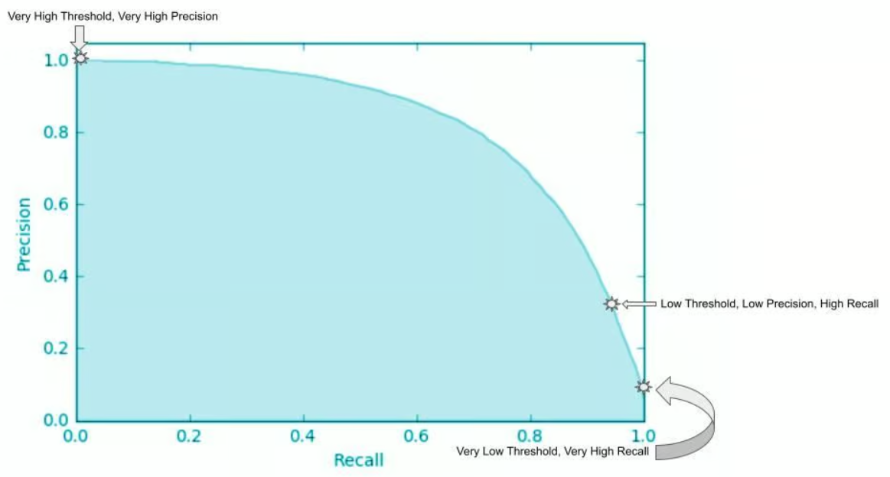
Object Detection
mAP (mean Average Precision)
- Simultaneous object localization and classification is benchmarked by the mean average precision (mAP).
- The average precision (AP) for a class of objects is the area under the precision-recall curve as the IoU threshold is varied. The mAP is the average of AP over all classes.
Ref: https://www.datacamp.com/tutorial/precision-recall-curve-tutorial

Slide 16
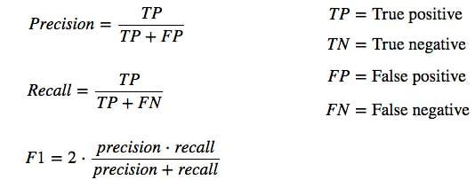
Object Detection
Precision, Recall, F1-score
- Precision measures how accurate is your predictions.
- Recall measures how good you find all the positives.

Slide 17
Object Detection
Challenges
- Scale and Complexity: The number of objects in the world is vast, and the complexity of their appearances makes it challenging to create comprehensive object recognition models.
- Real-time Processing: In many applications, real-time object recognition is crucial. Achieving fast and efficient processing while maintaining accuracy is a significant challenge.
- Large-scale Datasets: Building robust object recognition models requires extensive labeled datasets, which can be time-consuming and costly to create.
- Adaptability: Object recognition systems should be adaptable to new objects, scenarios, or environments without requiring extensive retraining.

Slide 18
Object Detection
Algorithms

Slide 19
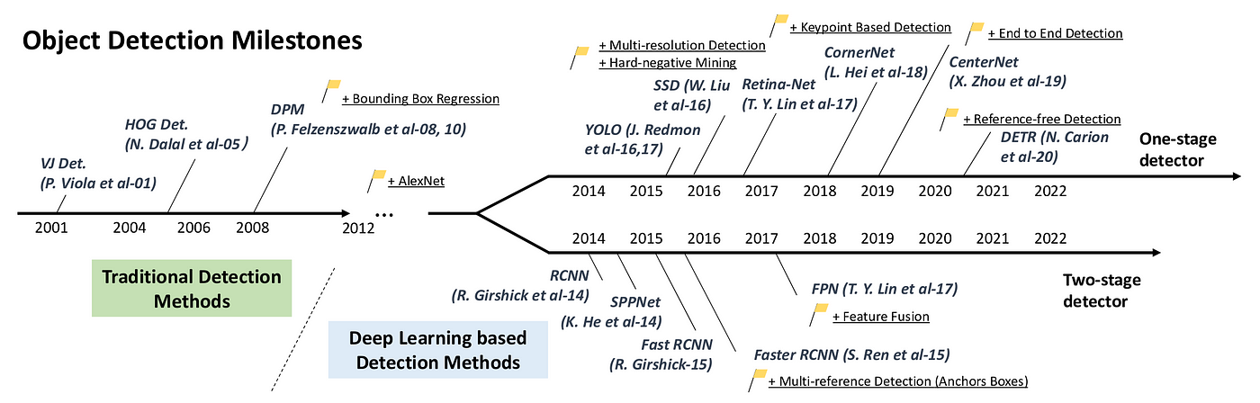
Algorithms
Evolution
- From traditional methods to deep learning.

Slide 20
Algorithms
Types
- Traditional pipeline
- Deep learning-based methods: SSD, YOLO, R-CNN, Faster R-CNN

Slide 21
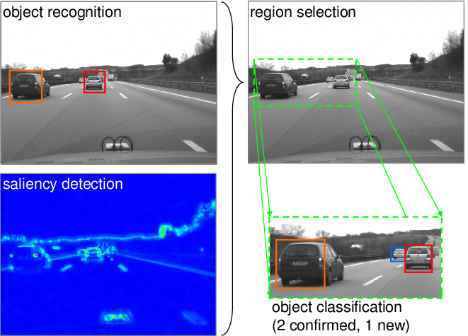
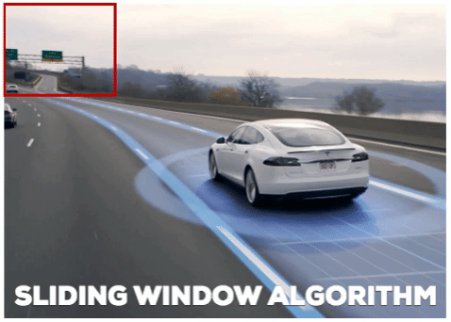
Algorithms
Traditional Pipeline
- Pre-processing
- Region of interest extraction (ROI): Sliding Window
- Object classification
- Refinement
Ref: https://www.labellerr.com/blog/why-do-autonomous-vehicles-need-object-detection/

Slide 22
Algorithms
YOLO
- YOLOv1
- YOLOv2
- YOLOv3

Slide 23
Thank You
anhtl@ut.edu.vn

